Slide 1
Does experiencing discrimination negatively impact health?
Daria Curley

Slide 2
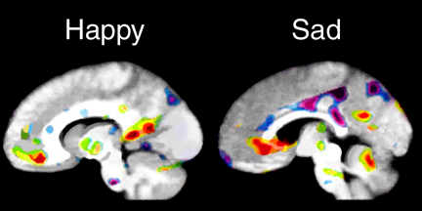
MENTAL ASPECT
+ discrimination =
(A. & J., 2004)

Slide 3
How does discrimination impacts my community?
Large Hispanic and African American communities
(city-data.com, 2015)
(State Wide Mobility, 2016)

Slide 4
THESIS
Discrimination negatively affects an individual’s mental health by increasing stress and lowering confidence in one’s self.
INCREASED STRESS
LOWER CONFIDENCE
DISCRIMINATION

Slide 5
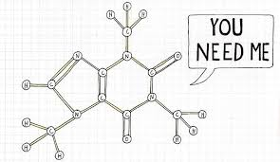
Reason 1: Increase in stress
Discrimination
(Root Wellness Studio, 2014)

Slide 6
Reason 2: Individual’s confidence lowers
“DISCRIMINATION AND STRESS WERE SIGNIFICANTLY ASSOCIATED WITH REDUCED SELF-ESTEEM” (Panchanadeswarana & Dawson, 2011)
(USIEF, 2016)
(Kellogg Health Scholars: Legacy Programs Alumni, 2016)

Slide 7
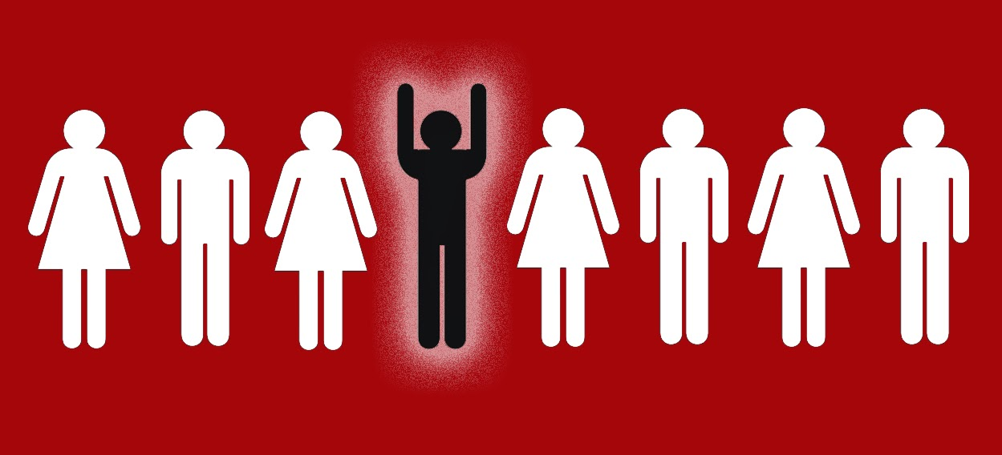
Counter Thesis: Positive Discrimination
The individual’s characteristic is being taken into account to benefit that individual, typically because that individual belongs to a group that is often treated unfairly.
(B News Journal, 2015)

Slide 8
How do we make it better?
Educating our youth to become more accepting and tolerant of all types of people
(abclearning.com, 2015)
(Dean, 2011)

Slide 9
References
A., B., & J., L. (2004). Kids’ Cingulate Kortex Korner. Retrieved April 26, 2016, from http://www.cingulumneurosciences.org/kids.shtml
Anticipated Discrimination Increases Stress Response. (2012, May 22). Retrieved April 15, 2016, from http://www.goodtherapy.org/blog/anticipated-discrimination-increases-stress-response-0522121
Australian Human Rights Commission. (n.d.). Retrieved April 19, 2016, from https://www.humanrights.gov.au/quick-guide/12078
BEVERLY ARAUJO DAWSON: Faculty Profiles : Adelphi University. (n.d.). Retrieved April 21, 2016, from http://www.adelphi.edu/faculty/profiles/profile.php?PID=0337
Gilhooley, D. (2008, December 29). Positive discrimination and positive action. Retrieved April 14, 2016, from https://www.timeshighereducation.com/news/positive-discrimination-and-positive-action/404799.article
Kellogg Health Scholars: Legacy Programs Alumni: Scholars in Health Disparities Program A - G. (n.d.). Retrieved April 22, 2016, from http://www.kellogghealthscholars.org/scholars/kellogg_alumni1.php
Panchanadeswarana, S., & Dawson, B. A. (2011, January 04). How Discrimination and Stress Affects Self-Esteem Among Dominican Immigrant Women: An Exploratory Study. Retrieved April 19, 2016, from http://www.tandfonline.com/doi/full/10.1080/10911350903341069
USIEF. (n.d.). Retrieved April 22, 2016, from http://www.usief.org.in/USF-2014-15/Fulbright-Nehru Academic and Professional Excellence Awards/Research/Panchanadeswar-Subadra.html
SUBADRA PANCHANADESWARAN : Faculty Profiles : Adelphi University. (n.d.). Retrieved April 21, 2016, from http://www.adelphi.edu/faculty/profiles/profile.php?PID=0418

